Slide 1
Information Processing Techniques
Week 08
Abeeha Sattar

Slide 2
Web Services

Slide 3
Consuming a Web Service
Create a WebService
Create an application that would consume the web service (e.g ASP.Net Web Application)
Include Web Reference of Web Service in the consuming application
Create an object of the WebService Instance and call functions

Slide 4
SOAP
It is important for web applications to be able to communicate over the Internet.
The best way to communicate between applications is over HTTP, because HTTP is supported by all Internet browsers and servers. SOAP was created to accomplish this.
SOAP provides a way to communicate between applications running on different operating systems, with different technologies and programming languages.

Slide 5
SOAP Building Blocks
A SOAP message is an ordinary XML document containing the following elements:
An Envelope element that identifies the XML document as a SOAP message
A Header element that contains header information
A Body element that contains call and response information
A Fault element containing errors and status information
All the elements above are declared in the default namespace for the SOAP envelope:
http://www.w3.org/2003/05/soap-envelope/
and the default namespace for SOAP encoding and data types is:
http://www.w3.org/2003/05/soap-encoding

Slide 6
Skeleton SOAP Message
<?xml version="1.0"?> <soap:Envelope xmlns:soap="http://www.w3.org/2003/05/soap-envelope/" soap:encodingStyle="http://www.w3.org/2003/05/soap-encoding"> <soap:Header> ... </soap:Header> <soap:Body> ... <soap:Fault> ... </soap:Fault> </soap:Body> </soap:Envelope>

Slide 7
Syntax Rules
Here are some important syntax rules:
A SOAP message MUST be encoded using XML
A SOAP message MUST use the SOAP Envelope namespace
A SOAP message MUST use the SOAP Encoding namespace
A SOAP message must NOT contain a DTD reference
A SOAP message must NOT contain XML Processing Instructions

Slide 8
The SOAP Envelope Element
The required SOAP Envelope element is the root element of a SOAP message. This element defines the XML document as a SOAP message.
<?xml version="1.0"?> <soap:Envelope xmlns:soap="http://www.w3.org/2003/05/soap-envelope/" soap:encodingStyle="http://www.w3.org/2003/05/soap-encoding"> ... Message information goes here ... </soap:Envelope>

Slide 9
The xmlns:soap Namespace
Notice the xmlns:soap namespace in the example. It should always have the value of: "http://www.w3.org/2003/05/soap-envelope/".
The namespace defines the Envelope as a SOAP Envelope.
If a different namespace is used, the application generates an error and discards the message.

Slide 10
The encodingStyle Attribute
The encodingStyle attribute is used to define the data types used in the document. This attribute may appear on any SOAP element and applies to the element's contents and all child elements.
A SOAP message has no default encoding.
soap:encodingStyle="URI“
<?xml version="1.0"?> <soap:Envelope xmlns:soap="http://www.w3.org/2003/05/soap-envelope/" soap:encodingStyle="http://www.w3.org/2003/05/soap-encoding"> ... Message information goes here ... </soap:Envelope>

Slide 11
The SOAP Header Element
The optional SOAP Header element contains application-specific information (like authentication, payment, etc) about the SOAP message.
If the Header element is present, it must be the first child element of the Envelope element.
Note: All immediate child elements of the Header element must be namespace-qualified.
<?xml version="1.0"?> <soap:Envelope xmlns:soap="http://www.w3.org/2003/05/soap-envelope/" soap:encodingStyle="http://www.w3.org/2003/05/soap-encoding"> <soap:Header> <m:Trans xmlns:m="https://www.w3schools.com/transaction/" soap:mustUnderstand="1">234 </m:Trans> </soap:Header> ... ... </soap:Envelope>
Notes:
The example contains a header with a "Trans" element, a "mustUnderstand" attribute with a value of 1, and a value of 234.
SOAP defines three attributes in the default namespace. These attributes are: mustUnderstand, actor, and encodingStyle.
The attributes defined in the SOAP Header defines how a recipient should process the SOAP message.

Slide 12
The mustUnderstand Attribute
The SOAP mustUnderstand attribute can be used to indicate whether a header entry is mandatory or optional for the recipient to process.
If you add mustUnderstand="1" to a child element of the Header element it indicates that the receiver processing the Header must recognize the element. If the receiver does not recognize the element it will fail when processing the Header.
soap:mustUnderstand="0|1“
<?xml version="1.0"?> <soap:Envelope xmlns:soap="http://www.w3.org/2003/05/soap-envelope/" soap:encodingStyle="http://www.w3.org/2003/05/soap-encoding"> <soap:Header> <m:Trans xmlns:m="https://www.w3schools.com/transaction/" soap:mustUnderstand="1">234 </m:Trans> </soap:Header> ... ... </soap:Envelope>

Slide 13
The actor Attribute
A SOAP message may travel from a sender to a receiver by passing different endpoints along the message path. However, not all parts of a SOAP message may be intended for the ultimate endpoint, instead, it may be intended for one or more of the endpoints on the message path.
The SOAP actor attribute is used to address the Header element to a specific endpoint.
soap:actor="URI“
<?xml version="1.0"?> <soap:Envelope xmlns:soap="http://www.w3.org/2003/05/soap-envelope/" soap:encodingStyle="http://www.w3.org/2003/05/soap-encoding"> <soap:Header> <m:Trans xmlns:m="https://www.w3schools.com/transaction/" soap:actor="https://www.w3schools.com/appml/">234 </m:Trans> </soap:Header> ... ... </soap:Envelope>

Slide 14
The SOAP Body Element
The required SOAP Body element contains the actual SOAP message intended for the ultimate endpoint of the message.
Immediate child elements of the SOAP Body element may be namespace-qualified.
<?xml version="1.0"?> <soap:Envelope xmlns:soap="http://www.w3.org/2003/05/soap-envelope/" soap:encodingStyle="http://www.w3.org/2003/05/soap-encoding"> <soap:Body> <m:GetPrice xmlns:m="https://www.w3schools.com/prices"> <m:Item>Apples</m:Item> </m:GetPrice> </soap:Body> </soap:Envelope>

Slide 15
The example in the previous slide requests the price of apples. Note that the m:GetPrice and the Item elements above are application-specific elements. They are not a part of the SOAP namespace.
A SOAP response could look something like this:
<?xml version="1.0"?> <soap:Envelope xmlns:soap="http://www.w3.org/2003/05/soap-envelope/" soap:encodingStyle="http://www.w3.org/2003/05/soap-encoding"> <soap:Body> <m:GetPriceResponse xmlns:m="https://www.w3schools.com/prices"> <m:Price>1.90</m:Price> </m:GetPriceResponse> </soap:Body> </soap:Envelope>

Slide 16
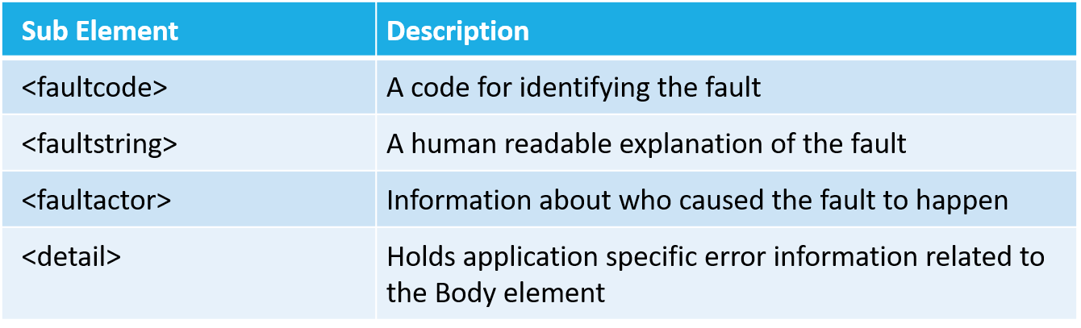
The SOAP Fault Element
The optional SOAP Fault element is used to indicate error messages.
The SOAP Fault element holds errors and status information for a SOAP message.
If a Fault element is present, it must appear as a child element of the Body element. A Fault element can only appear once in a SOAP message.
The SOAP Fault element has the following sub elements:

Slide 17
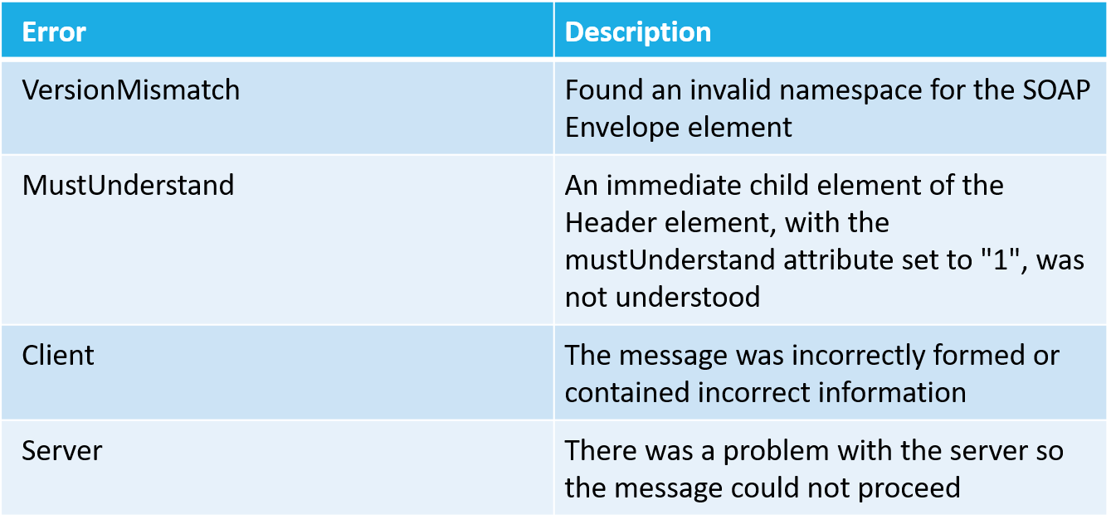
SOAP Fault Codes
The faultcode values defined below must be used in the faultcode element when describing faults:

Slide 18
SOAP Binding
The SOAP specification defines the structure of the SOAP messages, not how they are exchanged. This gap is filled by what is called "SOAP Bindings". SOAP bindings are mechanisms which allow SOAP messages to be effectively exchanged using a transport protocol.
Most SOAP implementations provide bindings for common transport protocols, such as HTTP or SMTP.
HTTP is synchronous and widely used. A SOAP HTTP request specifies at least two HTTP headers: Content-Type and Content-Length.
SMTP is asynchronous and is used in last resort or particular cases.

Slide 19
Content-Type
The Content-Type header for a SOAP request and response defines the MIME type for the message and the character encoding (optional) used for the XML body of the request or response.
Content-Type: MIMEType; charset=character-encoding
Example:
Content-Type: application/soap+xml; charset=utf-8

Slide 20
Content-Length
The Content-Length header for a SOAP request and response specifies the number of bytes in the body of the request or response.
Content-Length: bytes
Example:
POST /item HTTP/1.1 Content-Type: application/soap+xml; charset=utf-8 Content-Length: 250

Slide 21
In the example below, a GetStockPrice request is sent to a server. The request has a StockName parameter, and a Price parameter that will be returned in the response. The namespace for the function is defined in "http://www.example.org/stock".
POST /InStock HTTP/1.1 Host: www.example.org Content-Type: application/soap+xml; charset=utf-8 Content-Length: nnn <?xml version="1.0"?> <soap:Envelope xmlns:soap="http://www.w3.org/2003/05/soap-envelope/" soap:encodingStyle="http://www.w3.org/2003/05/soap-encoding"> <soap:Body xmlns:m="http://www.example.org/stock"> <m:GetStockPrice> <m:StockName>IBM</m:StockName> </m:GetStockPrice> </soap:Body> </soap:Envelope>

Slide 22
HTTP/1.1 200 OK Content-Type: application/soap+xml; charset=utf-8 Content-Length: nnn <?xml version="1.0"?> <soap:Envelope xmlns:soap="http://www.w3.org/2003/05/soap-envelope/" soap:encodingStyle="http://www.w3.org/2003/05/soap-encoding"> <soap:Body xmlns:m="http://www.example.org/stock"> <m:GetStockPriceResponse> <m:Price>34.5</m:Price> </m:GetStockPriceResponse> </soap:Body> </soap:Envelope>

Slide 23
Fin.

